Slide 1

Knee OA Classification Using Bone Distance
CS 671 Final Project
Tenzing Salaka
Sajud Hamza

Slide 2
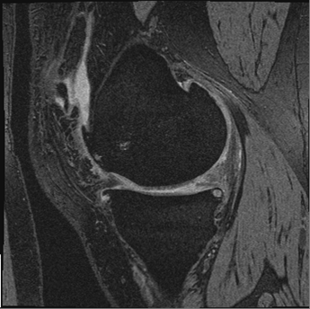
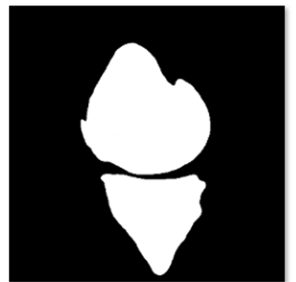


Problem & Approach
The Clinical Problem
The Vision Approach
Knee Osteoarthritis (OA) is measured by Kellgren-Lawrence (KL) grades (0-4). Grade 4 represents severe "bone-on-bone" contact. Accurate classification is critical for timely intervention.
Cartilage thickness is the key biomarker. We measure the minimum distance between the femur and tibia to find the Cartilage thickness.
Tenzing Salaka

Slide 3






System Pipeline
1. Input Sequence
2. Measurement
3. Classification
Input sequence of MRI bone masks (Femur & Tibia) generated via U-Net. 160 slices per patient.
Compute minimum Joint Space Width for every valid slice using Distance Transform.
Train a Multilayer Perceptron (MLP) on the distance feature vectors to predict OA.
Tenzing Salaka

Slide 4
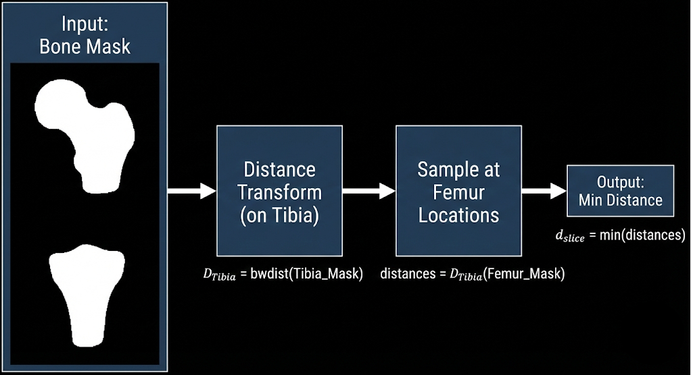

Initial Distance only Algorithm
We utilize the Euclidean Distance Transform (EDT) for efficiency.
•
Step 1: Calculate Distance Map (D_Tibia) for the entire image.
•
Step 2: Sample map at Femur pixel locations.
•
Step 3: Find global minimum.
Tenzing Salaka

Slide 5
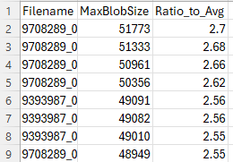
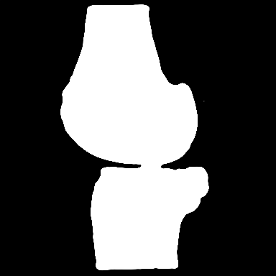


The Critical Discovery
The Flaw
The Consequence
Initial analysis showed a systemic issue with Grade 4 (Severe OA) cases. The segmentation model merged the touching Femur and Tibia into one single component. Our original logic discarded these as "noise" (< 2 bones).
The model was effectively blind to the most severe cases of disease. Initial classification accuracy was stuck at 76.1% because the defining feature of severe OA (fusion) was being filtered out.
Tenzing Salaka

Slide 6
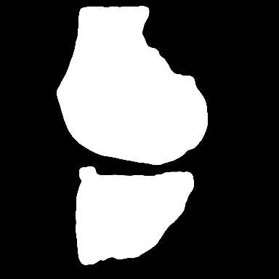
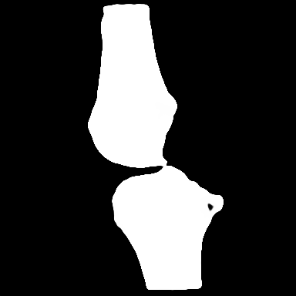
Adaptive Fusion Logic
9581915_109_pred
Ratio_to_Avg = 1.64
We came up with a solution based on physical properties using the Ratio_to_Avg metric (Component Area / Average Femur Area).
•
Ratio > 1.7: Data analysis confirmed these are FUSED (Distance = 0).
•
Ratio < 0.5: Confirmed as NOISE (Discard).
Validation: We isolated images with `Ratio_to_Avg > 1.7`. Visual inspection confirmed majority of these cases were fused bones, validating the statistical baseline (Avg vs Max).
Remark** There are some images around the ratio 1.7 that have minimal distance almost close to zero. These are not fused bones therefore on average might add error rates.
9189986_085_pred
Ratio_to_Avg = 1.74
Tenzing Salaka

Slide 7
Data Pipeline
Slice Selection
Restricted processing to slices 27–137 to avoid incomplete bone artifacts at sequence ends.
Normalization
Noise Reduction
Interpolated valid measurements to a fixed vector length of 100 features for MLP input.
Excluded the middle 40 slices (transition tissues) which confuse the measurement algorithm.
Sajud Hamza

Slide 8
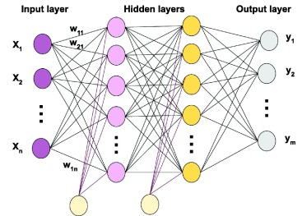
The Classifier: MLP
Why Neural Networks?
We selected a Multilayer Perceptron (MLP) because the relationship between bone distance and OA is non-linear.
•
Negative Weights: Learned that increasing distance generally reduces OA probability (healthy gap).
•
Positive Weights: Learned to identify osteophytes (bone spurs) at specific slice locations.
•
Validation: Used 10-Fold Cross-Validation with 200% Resampling.
Sajud Hamza

Slide 9
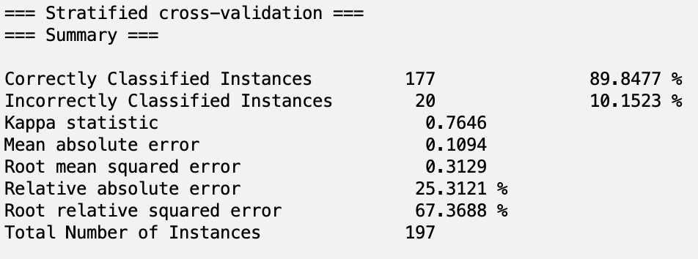
Performance Results V03KL
Sajud Hamza

Slide 10
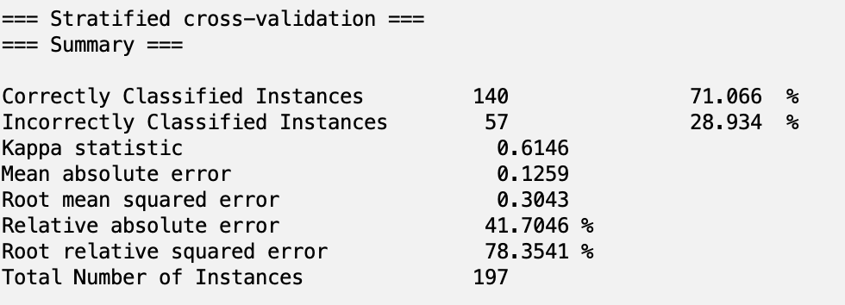
Performance Results V00XRKL
Sajud Hamza

Slide 11
Conclusion
89.8%
Key Achievements
Solved the "Fused Bone" edge case using adaptive area thresholding (Ratio > 1.5).
•
Demonstrated that excluding noisy transition slices improves signal quality.
•
Final Classification Accuracy
Sajud Hamza

